Slide 1

Portfolio vs S&P 500
Financial Markets Analytics
Potertì Daniele 844892
Sanvito Alessio 844785
Sanvito Simone 844794

Slide 2
INTRODUCTION
The objective of this project is to understand how a possible investment strategy could work and how risk can affect an investment in real portfolios.

Slide 3
CONTENTS OF THIS PROJECT
In this project we have:
Downloaded data from Bloomberg API data;
Preprocessed those data;
Built the rolling model;
Chosen the metrics needed to select the stocks (to be used to compose the portfolios);
Built equally weighted portfolios;
Rebalanced weekly the stocks in the portfolios and calculated the returns of those portfolios;
Analyzed the final results.

Slide 4
DOWNLOAD
Made with Bloomberg Excel Add-In
Last prices with daily granularity
Market index (S&P500)
All the stocks inside the market index
Pay attention to the survivorship bias

Slide 5
PREPROCESSING
Changed the names of the columns for more clarity (es. Apple → AAPL)
Inserted stocks that in the moment of download were no more in the index but have been part of it
N/A for the prices of those stocks before they entered
N/A for the prices of those stocks after they were removed
Attention if the stock is added again or if it was part of the index, then removed and then re-inserted

Slide 6
ROLLING MODEL
Calculation of log returns of every stock and of the index;
Rolling model which:
Uses linear regression;
samples the first 180 days and gives the value of the parameters at the 180th day;
Moves forward a week and calculates the parameters using data relative to the previous 180 days;
In the 7th day of the week it will have those parameters;
Goes on like this until the end of the period of 5 years;
At every iteration, it calculates the value of some parameters (using linear regression): R², σ_{i}², β_{i}σ_{M}², σ_{ei}², α_{i}, r_{i}.

Slide 7
STOCKS’ WEIGHT
The weights of the stocks have been assigned with the equally weighted method.
Same weight to every stock (it must be in the index in that week) of the portfolio.
When selected the 2% of best stocks, the weights are 1/(2%*number of total stocks)
When selected the 10% of best stocks, the weights are 1/(10%*number of total stocks)

Slide 8
R²
α
RETURN RISK RATIO
SELECTION OF THE PARAMETERS TO BUILD OUR PORTFOLIOS
We have ordered every parameter ascending and descending; then we selected the 10% and 2% of the upper quartile and of the lower quartile.
Measure of the relationship between the volatility of data and the correctness of the statistical model used
Excess return - the ability of an investment strategy to beat the market
Ratio between the return of the portfolio and the risk associated with that portfolio.

Slide 9
WEEKLY REBALANCING PORTFOLIO
At the end of the 7 days, stocks are been selected according to the strategy (𝛂, R², ratio). These stocks compose up the equally weighted portfolio for the next week
Then, for each portfolio, for each strategy weekly weighted returns have been calculated
Finally graphs have been plotted and a table has been created to summarize the results.

Slide 10
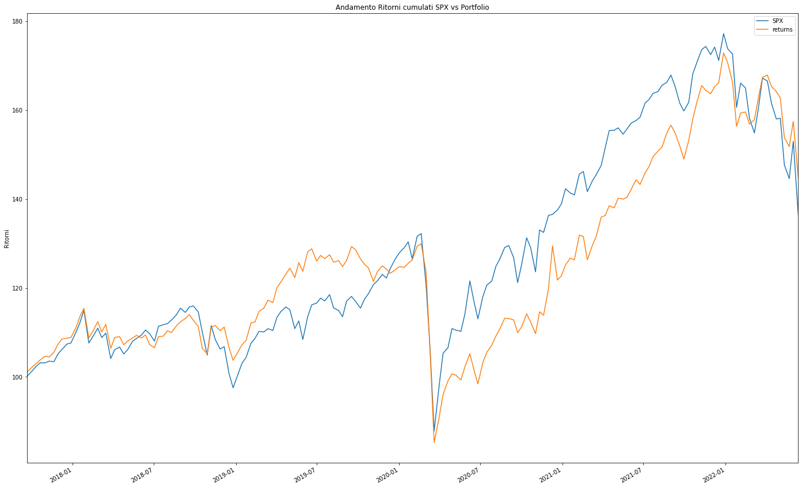
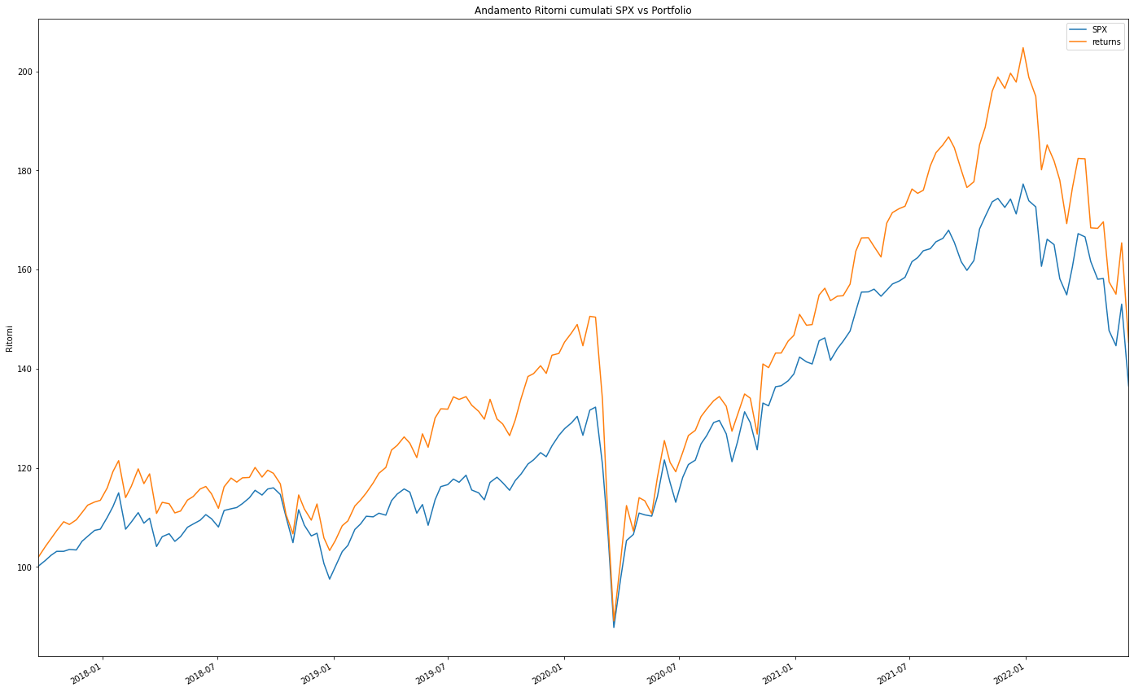
GRAPH
These are the graphs of the cumulative returns of the portfolios that overperform the market in terms of returns
2% RATIO UP
2% R² UP

Slide 11
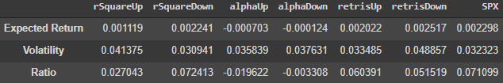
RESULTS 10%

Slide 12
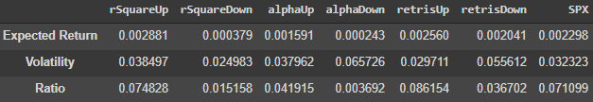
RESULTS 2%

Slide 13
THANKS

